Slide 1
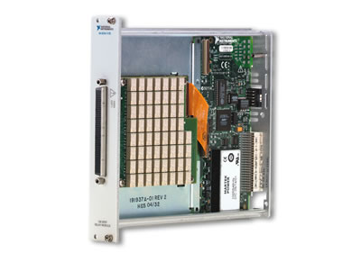
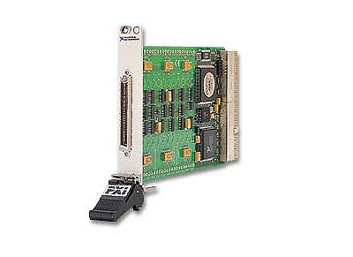
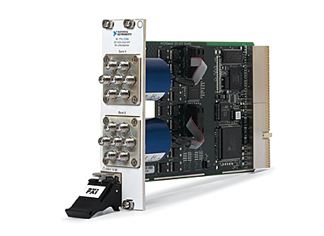
National Instruments Switches
Notes:
Changes 6/13/2012
New Template & Formatting Changes
Deleted Many Redundant Slides
Organizational changes (keeping all topologies together, keeping all expansion topics together, etc)
Added Slides
RF Topologies: RF Matrix
RF Topologies: RF Combiner / Switch
Application Examples
Measuring Low Capacitance with Switches
Other Examples slide
272x Resistor Modules
272x Design Overview
272x Design Overview (cont)
272x Device Support
NI 272x Reference VIs
272x Example Block Diagram
Good KBs
Slide Changes
Course Overview
Relay Life
Minimum Switching Current
Switching Capacitive Loads
NI SwitchBlock
What is UL
Voltage Switching Gone Bad
Programming NI Switches in LabVIEW
Scan List Syntax
Low Level Switch (removed)
Components of NI SwitchBlock
NI SwitchBlock Architecture
NI SwitchBlock Relay Cards
NI SwitchBlock Specifications
NI Switch Health Center
NI SwitchBlock Relay Card Specifications
Switching Low-Voltage Signals
NI RF Switch Products

Slide 2
Why the Need for Switches?
Nearly every system can benefit from switching
Increases channel count
Adds measurement flexibility
Simplifies test fixture
Decreases cost
Test | Instruments | Test Points | Solution
Stimulus/Resp | 1 Digitizer, 1 Arb | 20 DUTs | SWITCHING
Temperature | 1 DMM | 200 RTDs | SWITCHING
Notes:
Nearly every test system today uses some aspect of switching. In short, switching delivers the ability to connect a very high number of channels to a few test instruments, thereby reducing the amount of money required to build an automated test system. For example, with switching, you can connect one digitizer/arb to 20 DUTs for a stimulus/response test or one digital multimeter (DMM) to more than 200 RTDs for temperature measurements.
Switching also adds measurement flexibility for accommodating a variety of test fixtures at a significantly reduced cost compared to building a test system without switching. As a percentage, switching accounts for 30-50% of the cost of an automated test system, but the cost savings and throughput improvements after implementation can more than make up for the capital expense.

Slide 3
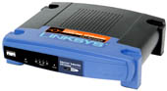
Test Architecture
Switch Hardware
Devices Under Test
DMM
Digitizer
Arb/FunctGen
Matrix
Power Supply
Gen. Purpose
RF Analyzer
Mux
RF Generator
Notes:
The typical test architecture today involves a number of different measurement devices (DMMs, digitizers, analyzers) and sources (power supplies, arbs, generators) that need be connected to devices under test.
In order to automate the connections and leave the test with the most flexibility, we often talk about using switches in between the measurements and the DUTs. Here, you can see examples of a matrix, general-purpose relay, and multiplexer.
The process of wiring everything together is often time consuming and complicated, but it can yield major throughput improvements for the system if done correctly. The switching is really the integral part of this connectivity scheme. (Action, Action, Action)

Slide 4
Course Overview
Switch Basics
Switch Topologies
Switching Modes
Relay Types
Relay Life
National Instruments Switches
Product Offering
Specifications
Using NI Switches
Controlling NI Switches
Installing NI Switches
Programming NI Switches
Connectivity and Expansion
Switch Connectivity
SCXI
PXI
SwitchBlock
Advanced Switching Topics
Application Examples
Resistor Modules
RF Switching

Slide 5
Switch Basics
Switch Topologies
Switching Modes
Relay Types
Relay Life

Slide 6
Switch Topologies
General Purpose, Multiplexer, Matrix, Fault Insertion, Independent
Notes:
The three most common switch topologies for switching applications are General Purpose (GP), Multipexer (Mux), and Matrix . The following slides will discuss the topologies in more detail and give NI examples of each.

Slide 7
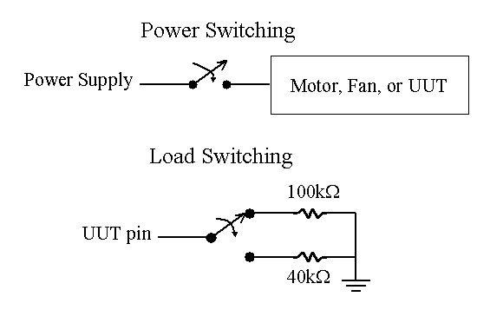
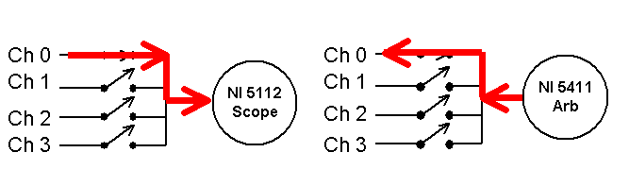
Common Switch Topologies
General Purpose
Matrix
NI 5122
Scope
NI 5421
Arb
Multiplexer
Notes:
In order to utilize switching in your test systems, it is important to understand the different types of switching topologies that are available.
The first and most common type is general purpose. These are just like the light switch on the wall – opening and closing to connect loads or switch power signals.
Slightly more complicated is the multiplexer topology. This is a combination of general purpose relays used to connect multiple signals to one common point. If you would like to measure ten channels into a digitizer, you can multiplex 10 to 1. You can similarly source 10 channels with an arb – the multiplexer is bi-directional.
Finally, if you connect simple relays in a matrix configuration, you can connect any row to any column, offering the most flexibility for signal routing. In this case, we show a DMM, scope, and arb connected to the rows and UUT points on the columns. We can connect any of these test units to any of the instruments, in any order or at the same time – hence, the flexibility of the matrix.

Slide 8
Topologies: General Purpose
Single -Pole Single -Throw (SPST)
Form A
Form B
Single -Pole Double -Throw (SPDT)
Form C
Individually controlled electromechanical relays
Used in automated control
Notes:
General purpose switching is comprised of individually controlled relays of form A, B or C. These relays have three common uses:
Isolated control and power switching
Automated test systems
Used as building blocks for larger more complex topologies
Single-Pole (SP) relays have only one source wire. Single-Throw (ST) relays can make a connection in only one position. Double-Pole (DP) relays have two source wires (usually + and -). Double-Throw (DT) relays can make a connection in one of two different positions.
Thus, SPST relays have one source wire and can have make only one connection. A SPDT relay has one source wire and can make one of two connections.
For a DPDT relay, the two source wires are linked and move together. Both poles are always in the same position.
Form A is a SPST relay that is normally open. Form B is a SPST relay that is normally closed. Form C is a SPDT relay that uses a “break-before-make” methodology. This means that the relay opens the connection between input and output before switching it.

Slide 9
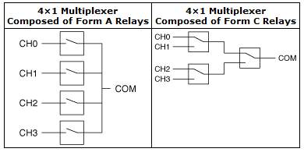
Topologies: Multiplexer
Multiple inputs to a single output
OR
A single input to multiple outputs
Notes:
A multiplexer typically connects one instrument to several units under test (UUT), or several instruments to one UUT. More generally, it can be described as allowing one or more inputs to be routed to a single output, or allowing a single input to be routed to multiple outputs.
With multiplexing, channel count is increased without the need for additional instrumentation. For example, let’s say you have one DMM that provides one input channel. You can use the mux shown on this slide to scan through 4 sensor readings with the one DMM.
A binary multiplexer is comprised of cascaded form C (SPDT) relays. In this form, all channel-to-common paths have the same path length. Only one channel is connected to the COM at any time. Unconnected channels are isolated by one or more open relays, which improves overall crosstalk performance. Also, this is a stubless topology that reduces high frequency reflections. This can be created by connecting Form C relays together. The resistance of each path is equal, and the frequency response of each path is also equal.
RF Multiplexers are typically form C.

Slide 10
Topologies: Matrix
C0
C1
C2
C3
C4
C5
C6
C7
R0
R1
4 x 8 Matrix
R2
R3
Any row can connect to any column
OR
Any column can connect to any row
Notes:
This is the most flexible and complicated of the switching topologies. It can be used to connect multiple instruments to many devices under test (DUT). Any input can be connected to any output. Matrices are typically used for automated test applications because of the simplified wiring schemes. The test system can change internal connection paths without any external manual intervention.

Slide 11
Matrix Configurations
DUT
DUT
DUT
DUT
DMM
Row-Column
Source
Digitizer
DMM
Source
Digitizer
DUT
DUT
DUT
DUT
DUT
R0
Column-Column
R1
R2
Notes:
Row-Column: Putting instruments on the rows and DUTs on the columns allows for easy DUT expansion or easy instrument expansion, but not both. This configuration is flexible in that it can be expanded by both rows and columns. In this example, to expand the number of both DUTs and instruments requires the addition of two more modules.
Column-Column: Putting both instruments and DUTs on the columns of a matrix allows for further expansion of both by adding only one more module and doing column expansion. This configuration is limited in the number of simultaneous connections that can be made being equal to the number of rows. To increase the number of possible simultaneous connections you must add additional modules for row expansion.

Slide 12
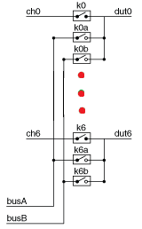
Topologies: Fault Insertion Topology (FIU)
Allows faults to be inserted between measurement devices and a DUT
Used in HIL Applications
Combines SPST with MUX topologies
Notes:
Fault Insertion Topology allows you to put a switch into a system, and in normal conditions, the channel is closed to the dut and it is as if the switch is not there. However, the user has the ability to open or short any channel, allowing for the insertion of faults at the dut. This topology is used in HIL (Hardware in the loop) testing.
For example, BMW uses out 2510 FIU to test their engines. They are able to introduce shorts in order to verify that the engine behaves in a safe manner, regardless of wiring faults.

Slide 13
Topologies: External Relay Driver (PXI-2567)
High voltage/current motor
Motor
High Power
Relay
NI Switch Module
+
-
NI
Relay Driver
Notes:
This figure represents a standard system where the relay is used to close a circuit between a power supply and a load. If the rating of the load exceeds the rating of the relay then, a new relay needs to be installed. To drive this new high power relay, you can use a relay driver which will close the circuitry between the new high power relay and its power supply.
National Instruments relay drivers are the ideal choice when the current and voltage requirements for relays exceed those found in existing relay modules (or for relays embedded in a test system). Like NI switches, relay drive modules are controlled with NI-SWITCH driver software, so engineers can program external relays connected to the relay driver and standard PXI and SCXI switch modules identically. For added safety against flyback voltages, a flyback diode has been added across the relay. The SCXI-1167 has a 5 V source and the PXI-2567 has a 5 V and a 12 V source available to drive relays. The 5 V source on the SCXI-1167 can provide up to 0.75 A of current. The 5 V source on the PXI-2567 can provide up to 1.25 A of current and the 12 V source can proved 0.50 A of current.

Slide 14
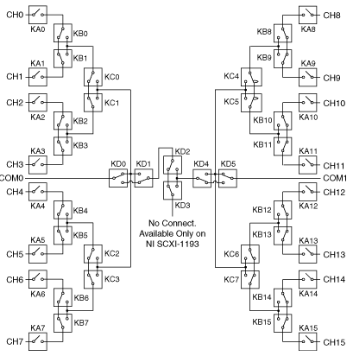
Independent Topology
Allows you to utilize any connection that is physically possible with the module
Allows for custom topologies
Can control every individual relay on the board using the Relay Control functions and Connect Channels functions
PXI-2593’s Independent Topology
Notes:
Select this topology to utilize the full routing capabilities of the Switch Module. The Independent topology allows every relay on the board to be accessed. With the independent topology, you can control the individual relays using the niSwitch Relay Control VI or the niSwitch Relay Control function, or you can use the niSwitch Connect Channels VI or the niSwich Connect function.
For example, the NI PXI-2593 supports the independent topology. Possible configurations include 3x1 multiplexers and dimensionally flexible sparse matrices. For another example, when measuring stacked signals, use the independent topology to configure the NI PXI-2584 as an interleaved multiplexer.

Slide 15
RF Topologies: Sparse Matrix
Uses two multiplexers
Any row can connect to any column
Only one path allowed at a time
Typically used in RF applications to eliminate stubs
C0
C1
C2
C3
R0
R1
R2
R3
4 x 4 Sparse Matrix
Notes:
A sparse matrix is made using two multiplexers and connecting their commons as illustrated in the diagram. The COM connection of the switch module provides the row-columns of a matrix. It will connect any input from the first multiplexer to any input from the second multiplexer. This configuration provides an equidistant path for all connections from each end. The advantage of this is that each path will have the same impedance. However, only one connection can be made at a time. You may also prefer a sparse matrix if you are concerned about safety and do not want to short any inputs R.

Slide 16
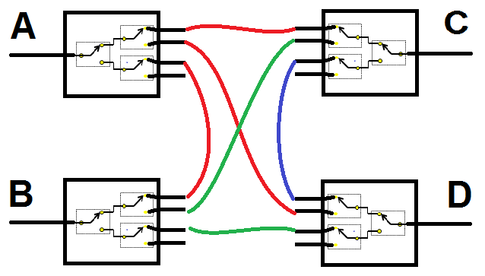
RF Topologies: Blocking Matrix
Used in RF applications to minimize stubs
Requires N MUXs of size (N-1)x1
Any external terminal can connect to up to one other terminal, e.g. A->B, A->C, but not both simultaneously
Notes:
A typical matrix will have stubs (the name for the unused, unconnected portion of the matrix row or column). These stubs are un-terminated and allow reflections which degrade VSWR, to be discussed later. While VSWR is not an important factor at low frequencies, managing these stubs is important in High Frequency applications like those in RF systems.
Blocking Matrices are arranged in such a way so as to not have stubs. To do this, we use a series of form C multiplexers to make one continuous path, from source to load with no stubs.
Requires N Multiplexers of size (N-1)x1
Any terminal can connect to up to one other terminal
N/2 simultaneous connections
Always used in RF applications

Slide 17
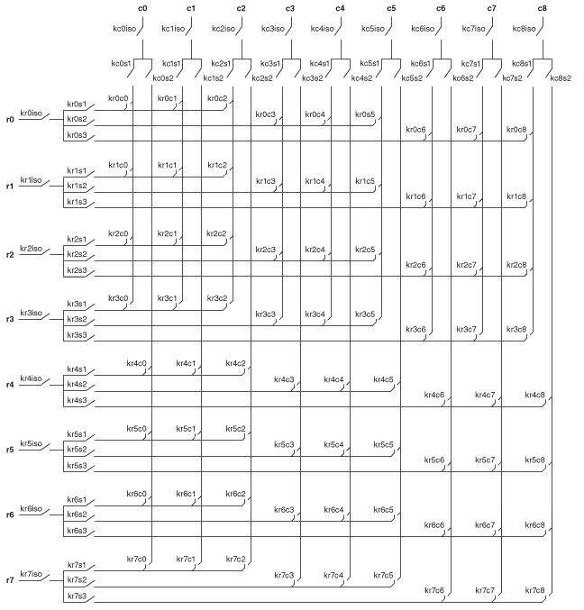
RF Topologies: RF Matrix
Unconnected pins can cause RF switches to lose bandwidth.
RF matrices (2540, 2541) have isolation relays to allow users to limit the number of unconnected pins on a signal path.
Making connections are identical to normal matrices and additional isolation relays are unseen to the customer

Slide 18
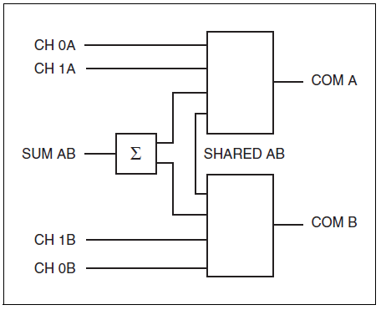
RF Topologies: RF Combiner / Switch
Some customers may want to “combine” or add signals together.
Using the 2790 RF combiner allows users to do this.
This is done by switching the COM A Signal with the COM B Signal through SUM AB

Slide 19
Switching Modes
1-wire
2-wire
4-wire
Notes:
The three most common switch topologies for switching applications are General Purpose (GP), Multipexer (Mux), and Matrix . The following slides will discuss the topologies in more detail and give NI examples of each.

Slide 20
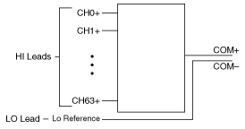
1-Wire Switching Mode
e.g. This is a 1-wire 64x1 MUX similar to RSE measurements for a multifunction DAQ
Notes:
NI switch modules are capable of switching 1, 2 and/or 4-wires.
In 1-wire mode, you connect the positive leads to the relays and the negative leads to the COM connection. All signals are referenced to this COM connection. All NI multiplexers, other than the NI SCXI-1163R, can operate in 1-wire mode.
Sometimes more than one signal needs to be switched at the same time. In this situation a switch that employs 2-wire or 4-wire mode can be used.

Slide 21
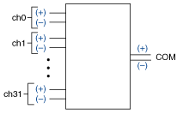
2-Wire Switching Mode
e.g. This is a 2-wire 32x1 MUX similar to Differential measurements for a multifunction DAQ
Notes:
In 2-wire mode, you connect both positive and negative leads to the terminals of a channel. An advantage of 2-wire switching is great common-mode noise rejection. Some applications in which 2-wire is typically used are differential measurements, low voltage, high current, and resistance measurements in the 100 – 10 M Ohm range.

Slide 22
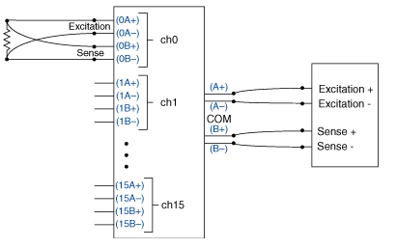
4-Wire Switching Mode
e.g. This is a 4-wire 16x1 MUX
Notes:
4-wire mode is usually used for 4-wire resistance measurements. Two leads are used for the current excitation and another two leads are used for measuring the voltage drop across the resistor.

Slide 23
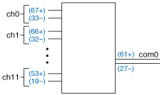
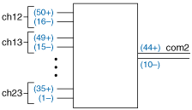
Multiple Bank Multiplexers
e.g. This is a Dual 2-wire 12x1 MUX. Both are on the same switch module.
Notes:
Some modules have topologies that are made up of a number of smaller banks of switches. As the module is configured in different topologies, internal relays open or close, connecting these banks in new configurations. Some topologies will open the relays between banks in order to give you access to multiple mutually exclusive banks or topologies. Each bank is individually controllable in software.

Slide 24
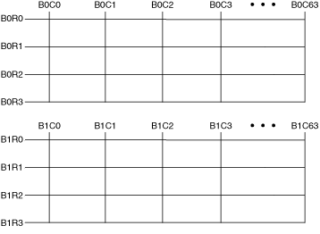
Multiple Bank Matrices
e.g. This is a Dual 4x64 Matrix. Both are on the same switch module.

Slide 25
Relay Types
Electromechanical Armature
Latching
Non-Latching
Electromechanical Reed
Solid State Relays
FET Relays
Notes:
The three most common switch topologies for switching applications are General Purpose (GP), Multipexer (Mux), and Matrix . The following slides will discuss the topologies in more detail and give NI examples of each.

Slide 26
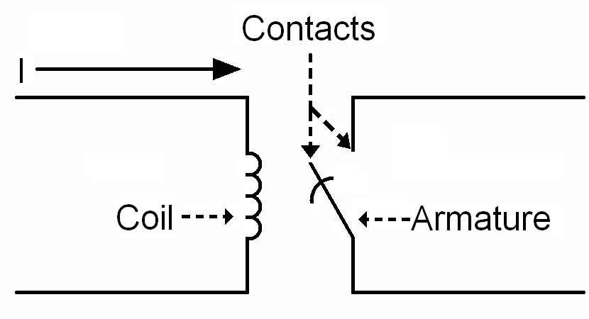
Electromechanical Armature
Notes:
As current flows through a coil parallel to the armature, a magnetic field is induced. As a result, the armature moves and either opens or closes the contacts. How it moves depends on whether it is a latching or non-latching relay.

Slide 27
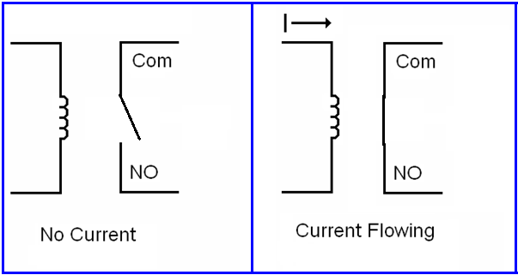
Armature: Non-latching (SPST)
Relay closes when coil energizes
Relay opens when power turned off
Note: NO=Normally Open
Notes:
A non-latching relay functions as follows: Whenever current is not flowing through the coil, the armature rests in a standard position, Normally Closed (NC) above. When current flows, the induced magnetic field swings the armature to a different position, Normally Open (NO) above.

Slide 28
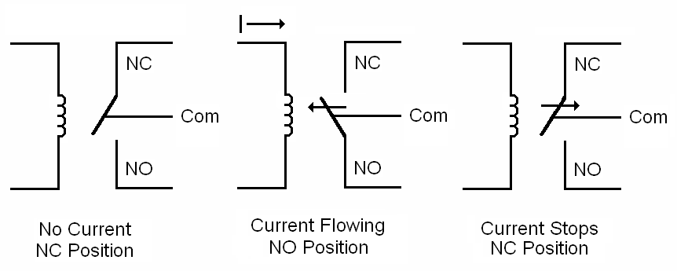
Armature: Non-latching (SPDT)
Relay closes when coil energizes, connecting normally open to Com
Relay opens when power turned off, connecting normally closed to Com
Notes:
A non-latching relay functions as follows: Whenever current is not flowing through the coil, the armature rests in a standard position, Normally Closed (NC) above. When current flows, the induced magnetic field swings the armature to a different position, Normally Open (NO) above.
Not all SPDT relays are latching, and you can have latching SPST.

Slide 29
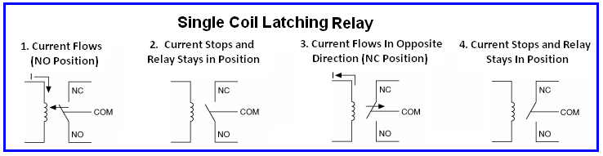
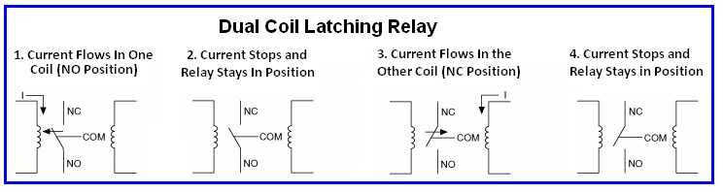
Latching (Behind the Scenes)
Relay remains in last set position until next operation
Notes:
Latching relays typically come in one and two coil configurations.
A single coil latching relay positions the armature depending on the direction of the current. Stopping current flow does not swing the armature as it does with a non-latching relay.
A dual coil latching relay positions the armature depending on which coil has current flow through it.

Slide 30
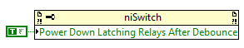
Armature: Latching Relays
Reduces noise for low level signal measurements
Allows more simultaneous relays to be driven (PXI has limited power)
Use the Power Down Latching Relays After Debounce property to de-energize relay
Latching is an attribute of the switch module/relay not the programming (check specifications)
Notes:
Latching relays typically come in one and two coil configurations.
A single coil latching relay positions the armature depending on the direction of the current. Stopping current flow does not swing the armature as it does with a non-latching relay.
A dual coil latching relay positions the armature depending on which coil has current flow through it.

Slide 31
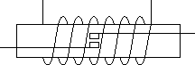
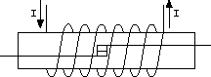
Electromechanical Reed Relay
Coil
Two reeds physically contact when the coil is energized
When coil is de-energized, reed spring force separates reeds
Smaller than armature relays (allows higher channel count)
Faster than armature relays
Not as robust as armature relays, particularly with overcurrent
Reed
Contact
Inert Gas
Notes:
When the coil is energized, the two reeds physically contact. When the coil is de-energized, the spring force in the reeds pulls the reeds apart.
Reed relays are smaller and can actuate much faster than the armatures in electromechanical relays. However, they are more susceptible to damage from arcing than armature relays. Arcing is the electrical breakdown of a gas in the space between two conductive electrodes which results in a very high temperature and a continuous discharge of current between the two electrodes.
Note: Reed relays have a longer life than armatures because they are more isolated (in a glass capsule) and see less mechanical action so they will not wear out as fast.

Slide 32
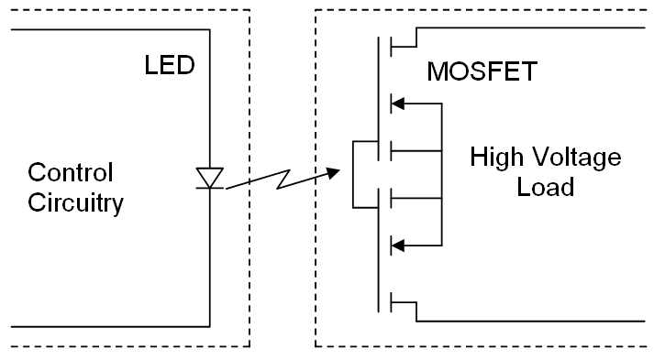
Solid State Relay
Photo-sensitive MOSFET responds to light from LED
Isolation barrier allows relay to switch high voltages
LED restricts switching speed
Faster than electromechanical relays
Infinite life when used within specifications
Notes:
Solid-state relays offer optical isolation. They are made of an LED and MOSFET. The control circuitry turns on the diode, which emits light. A Photo MOSFET receives the light and closes a load circuit. By providing isolation this relay can switch up to 300V on some modules. It takes about 1ms (depending on the relay) for the LED to turn on , and 0.5 ms for the LED to turn off. These times restrict the switching speed or this relay. They are faster than electromechanical relays.

Slide 33
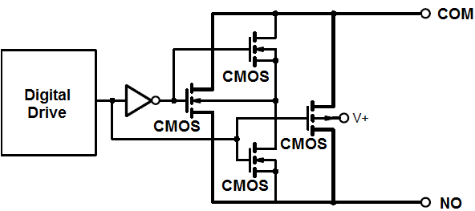
FET Switch
CMOS transistors
No additional isolation between the control circuitry and the signal path
Low voltage (±10V)
Very fast switching rate
Unlimited lifetime
Very easily damaged
Transparent to user
Notes:
The FET Switch gives most of the same benefits as the solid-state relay except that it uses a direct control circuit with no optical isolation. This makes faster than SSRs since they are not limited by LED speed, but more susceptible to damage if overvoltage conditions occur.
FET switches are made of several CMOS transistors. A voltage is applied to Vin (control circuitry), which connects the source and drain of a same transistor (load circuit). Other voltages are applied to V+, Vl, and V- to power the circuitry. There is no isolation between the control circuitry, which restricts the load voltage usually to +/- 10V but allows very fast switching speed up to 250000 S/s.
Note: Despite similarities in their names, Solid State Relays (MOSFET) and FET switches are completely different. FET switches do not use LEDs for isolation like MOSFET switches do and therefore can switch faster.

Slide 34
Relay Life
Relay Life Basics
Preventative Methods
Notes:
The three most common switch topologies for switching applications are General Purpose (GP), Multipexer (Mux), and Matrix . The following slides will discuss the topologies in more detail and give NI examples of each.

Slide 35
Relay Life Basics
Electromechanical relays have a known lifetime that is listed in the Specifications.
This lifetime is a “Bell Curve” Estimate of expected relay life
All Electromechanical relays will fail at some point.
There are methods to delay the inevitable.
FET and SSR relays will last a very long time if used within specifications.
Out of specification use will easily damage FET and SSR relays.
Abuse of FET relays can cause damage to module.
Notes:
KB# 3ALGM32G describes relay life as well as the Help File

Slide 36
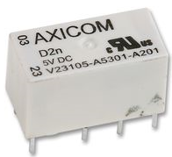
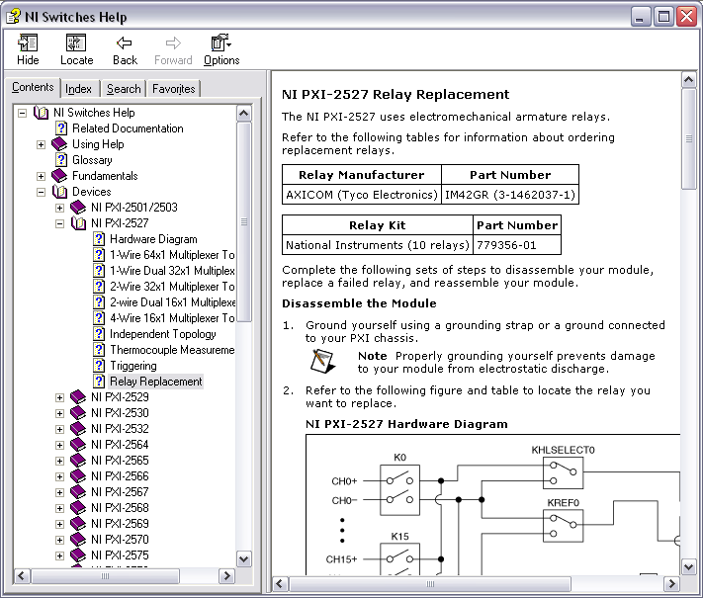
Predictive Maintenance
Disclaimer: predicting relay life is never as easy as people claim
Inductive vs. capacitive vs. purely resistive loads
Statistical variations on relays
Tools available to assist in predictive maintenance
Relay count tracking on NI switch modules
Relay replacement instructions
Spare relay kits

Slide 37
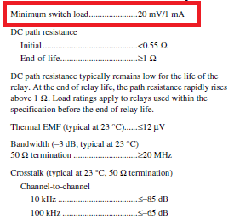
Minimum Switching Current/Voltage with Electromechanical Relays
Contaminants slowly build up on the relay contacts
A minimum load is required to spark and burn off particulate in order to form a solid connection
Note: Reed, SSR, and FET relays are not affected
ALL Electromechanical Armature Relays have issues with low signal levels.
Notes:
Minimum Current Required for Burn-off Another concern is the current required to burn off very small particles on the contacts of armature relays. When relays are in their open position, small particles can accumulate on the contacts for the closed position. When contact is made, a minimum amount of current is needed to burn off these particles and establish the connection. For smaller relays this amount is in the mA range. For relays with a higher maximum current rating, the contacts are larger and thus a greater area is available for particle deposition and a greater amount of current is required to burn off these particles. Reed relays are not subject to this problem because the contacts are encapsulated in a noble gas. Note: Reed relays not affected because sealed in a noble gas or vacuum tube
Note: SSR and FET relays are not affected since are not mechanical, so nothing to foul up, they are isolated in silicon

Slide 38
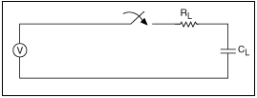
Switching Capacitive Loads
Need to protect relays from high inrush currents caused by capacitor charge/discharge
DMM / Power Supplies / SMU / Cables / EVERYTHING has capacitive values that can cause damage.
High inrush can cause relays contacts to weld
High current from a Voltage Source (Power Supply / Capacitor) charging another Capacitor (cables, etc)
Add a resistor in series with the relay to limit maximum current.

Slide 39
Switching Inductive loads
Inductors resist a change in current and create a very high voltage when they are disconnected.
This high voltage can damage relays and other components.
Use Zener Diodes/Metal Oxide Varistors to provide a dissipation path for this excess voltage.
Known as Inductor Flyback Protection
Notes:
Adding metal oxide varistor and/or zener diode pair prevents overvoltage conditions from damaging relays. For inductive loads, relay damage will occur because inductors resist a change in current. Therefore, if 1A is flowing while the relay is closed through a 4 Ohm resistor, when we open the relay the 1A will still flow, but now the resistance is really high (say 1MOhm). 1A*1Mohm=1MV=large spark on relay contact.

Slide 40
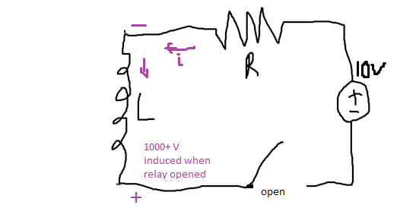
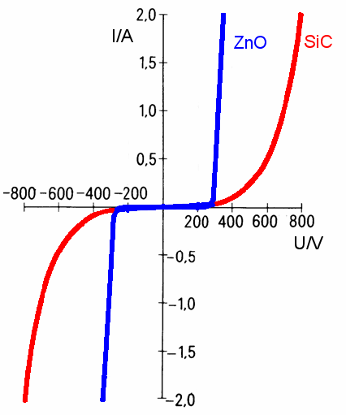
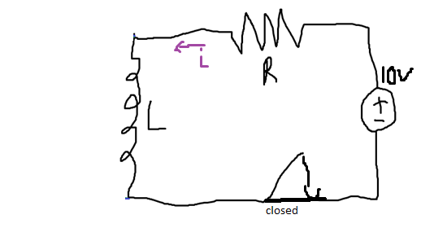
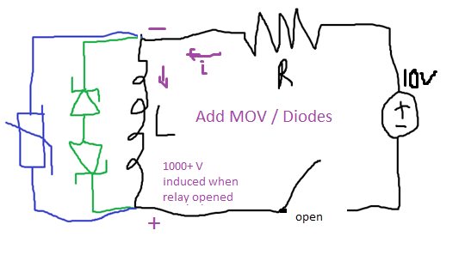
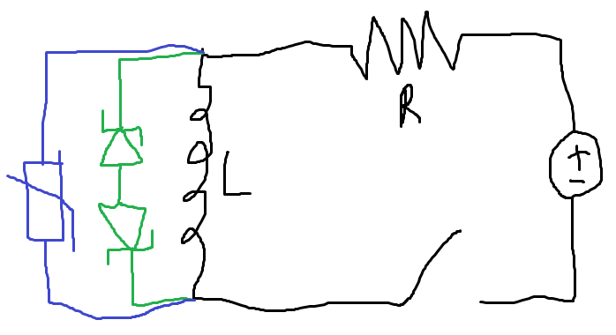
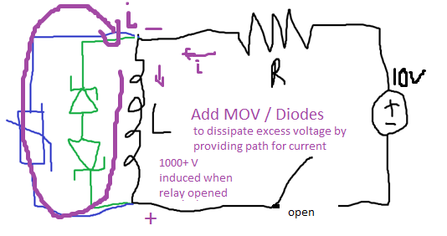
Switching Inductive loads Cont.
Zener diodes last forever, but take microseconds to respond
MOVs last ~10,000 cycles, but react in ns
For best results, use both
No current flows until excessive voltage
Notes:
Adding metal oxide varistor and/or zener diode pair prevents overvoltage conditions from damaging relays. For inductive loads, relay damage will occur because inductors resist a change in current. Therefore, if 1A is flowing while the relay is closed through a 4 Ohm resistor, when we open the relay the 1A will still flow, but now the resistance is really high (say 1MOhm). 1A*1Mohm=1MV=large spark on relay contact.

Slide 41
Relay Types and Capabilities
Capabilities | Armature | Reed | FET | SSR
High-Power
High-Speed
Density/Module
Relay Life
Best
Good
Better
Better
Good
Better
Best
Better +
Good
Best
Best
Better
Good
Better
Best
Best
Notes:
SSR are significantly faster than reeds.

Slide 42
QUIZ
What are the different types of relays NI uses?
Which relay type has the longest lifetime?
Which relay type is the fastest?
What happens on a latching relay when the current stops flowing through the coil?
Notes:
1. Armature, Reed, Solid State, FET
2. FET/ SSR – unlimited lifetime
3. FET
4. Stays in same position

Slide 43
National Instrument Switches
Product Offering
Specifications

Slide 44
Product Offering
Form Factor
Switching Products By Application
Notes:
The three most common switch topologies for switching applications are General Purpose (GP), Multipexer (Mux), and Matrix . The following slides will discuss the topologies in more detail and give NI examples of each.

Slide 45
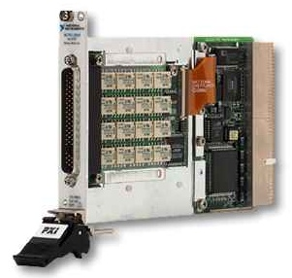
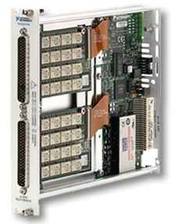
Form Factors
PXI-2566
NI offers switches in both PXI and SCXI form factors
Benefits of PXI platform
Industry standard, nonproprietary platform
Multiple instruments in same chassis
Largest selection of modules
Benefits of SCXI platform
Allows users to control switches via USB or PCI
Primarily for legacy switching applications
Never recommend for new applications
SCXI-1166

Slide 46
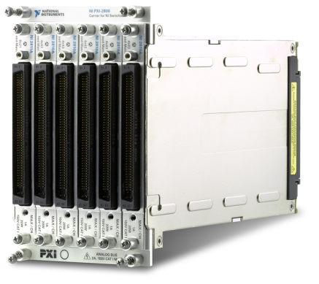
NI SwitchBlock
Carrier that has 6 slots, fitting into 4 PXI slots
Can be configured as a single giant matrix or multiple smaller matrices.
Easily Expandable
Self Test Functionality
Modules fit inside carrier.
Notes:
Used for large matrix applications. This is an advanced switch topic and will be discussed later in this training.

Slide 47
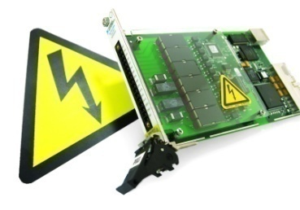
Voltage Switching
NI Switches:
All NI modules capable of routing hazardous voltages (larger than 60VDC or 30Vrms) are UL certified
NI makes industry’s highest voltage UL certified PXI module
Exceed CAT I and/or CAT II transient voltage requirements
High-voltage switching applications
Fuel Cell Test
Switching wall outlet signals (CATII)
Mid to high-voltage switching applications
General-purpose signals
Automotive applications (42 V signals)
Low-voltage switching applications
ICT Test (Opens and Shorts)
Thermocouple measurements
Notes:
60VDC=30Vrms=42.2 Vpeak

Slide 48
Voltage Switching Product Offering
Multiplexer
Matrix
General-purpose
RF
PXI-2584 (600 V)
PXI-2527 (300 V)
PXI-2585 (300 V)
SCXI-1127 (300 V)
SCXI-1128 (300 V)
300 - 600 V
No modules
available
PXI-2586 (300 V)
No modules
available
PXI-2565 (250 V)
PXI-2564 (150 V)
PXI-2566 (150 V)
PXI-2568 (150 V)
PXI-2569 (100 V)
PXI-2570 (100 V)
PXI-2593 (150 V)
PXI-2596 (90 V)
PXI-2597 (90 V)
PXI-2503 (60 V)
PXI-2576 (100 V)
PXI-2530 (60 V)
PXI-2575 (100 V)
PXI-2503 (60 V)
PXI-2529 (150 V)
PXI-2530 (60 V)
PXI-2532 (100 V)
60 - 150 V
PXI-2591 (24 V)
PXI-2594 (30 V)
PXI-2595 (30 V)
PXI-254x (30 V)
PXI-255x (30 V)
PXI-2501 (10 V)
PXI-2501 (10 V)
No modules
available
10 - 30 V

Slide 49
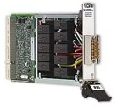
Current Switching
NI’s competitive advantage:
Strict adherence to safety
Breadth (NI offers matrix, multiplexer, and general-purpose modules)
High-current switching applications
Automotive applications
Switching high-power loads (lights, fans, motors, etc.)
Switching power supplies
Mid-current switching applications
General-purpose signals
Automotive ECU testing

Slide 50
Current Switching Product Offering
Multiplexer
Matrix
General-purpose
RF
No modules
available
PXI-2564 (5 A)
PXI-2565 (7 A)
PXI-2586 (12 A)
No modules
available
High Current
PXI-2585 (12 A)
PXI-2501
PXI-2503
PXI-2527
PXI-2530
PXI-2575
PXI-2576
PXI-2584
PXI-2501
PXI-2503
PXI-2529
PXI-2530
PXI-2532
PXI-2566
PXI-2568
PXI-2569
PXI-2570
PXI-259x
PXI-254x
PXI-255x
Mid Current

Slide 51
Density Switching
NI’s competitive advantage:
Matrix density = crosspoints Multiplexer density = channels
Continuous development
High-density matrix switches with unlimited lifetime and unlimited simultaneous connections
High-density switching applications
ICT test (testing opens and shorts)
Test system routing
Usually matrix applications
Mid-density switching applications
Testing small PCBs or chips
High-density applications that require > 0.5 A switching current
Usually multiplexer or control apps
Low-density switching applications
Testing small number of DUTs or DUT with few channels
Usually multiplexer or control apps

Slide 52
Density Switching Product Offering
Multiplexer
Matrix
General-purpose
RF
PXI – 2532 (512 Xpt)
PXI – 2533 (256 Xpt)
PXI – 2534 (256 Xpt)
PXI – 2535 (544 Xpt)
PXI – 2536 (544 Xpt)
No modules
available
No modules
available
No modules
available
256 – 512 ch
PXI-2527
PXI-2530
PXI-2532
PXI-2575
PXI-2576
PXI-2529 (128 Xpt)
PXI-2530 (128 Xpt)
PXI-2569
PXI-2570
No modules
available
128 – 196 ch
PXI-2501
PXI-2503
PXI-2584
PXI-2585
PXI-2564
PXI-2565
PXI-2566
PXI-2568
PXI-2586
PXI-2501
PXI-2503
PXI-259x
PXI-254x
PXI-255x
PXI-279x
10 – 32 ch

Slide 53
Specifications
Notes:
The three most common switch topologies for switching applications are General Purpose (GP), Multipexer (Mux), and Matrix . The following slides will discuss the topologies in more detail and give NI examples of each.

Slide 54
Common Switch Specifications
Bus Type (PXI, SCXI, etc.)
Topology (External Relay Driver, General Purpose, Matrix, Multiplexer, RF, etc.)
Relay Type (Armature, Reed, FET, Solid State, etc.)
Connection Speed (Scan Rate, Operate Time)
Measurements to Perform (Accuracy, Resolution, etc.)
Maximum/Minimum Voltage/Current
Maximum Power
Maximum Bandwidth
Crosspoint/Channel Density
DC Isolation
Safety (CAT I/II)
Notes:
The specifications are things to consider when selecting a switch module for your application.

Slide 55
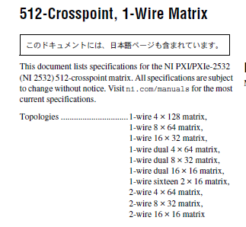
DEMO! - Example Switch Specification Page
Open the PXI-2532 Spec Sheet and walk through

Slide 56
Hot Switching vs Dry Switching
Hot Switching:
Moving relay when current/voltage is applied
Causes sparks that degrade relay surface; Sparks = heat = melted contacts (i.e. bad news bears)
Reduces relay lifetime
Use series shunt resistors to minimize inrush currents
Dry (Cold) Switching
Moving relay with no current/voltage applied
Prolongs relay life
Not always possible depending on test equipment

Slide 57
Switching Current vs Carry Current
Switching Current
This is the current that the relay contacts can withstand without damage when switching (moving)
Almost always a limitation of the relay
Carry Current
Current the module is specified to carry after the relay has been closed (typically the same or higher than switching current)
Almost always a limitation of cabling

Slide 58

What is UL?
UL Certified ensures but is not limited to the following
Product being safe to touch in normal use-cases
Product being able to safely handle voltage spikes
Product having adequate distance and insulation between high voltage lines and ground
UL Measurement Categories
CAT I = Voltages that are isolated from the power source
CAT II = Line Voltages
CAT III = Building main voltages
CAT IV = Power line transmission
Notes:
Underwriters Laboratories (UL) is an independent product safety certification organization. They validate and test products to ensure with stringent safety regulations to protect users from accidental injury.
http://en.wikipedia.org/wiki/Underwriters_Laboratories
http://en.wikipedia.org/wiki/Measurement_category

Slide 59
Voltage Switching Gone Bad
Exceeding isolation specifications
Arcing could occur
Hot switching when cold switching is possible
Purchasing a module that does not meet safety specs (Voltage ratings, CAT I/II)
Switch signals that are lower than minimum specifications
Notes:
Cold Switching refers to making or closing the channel connection before current begins to flow. Often times Switch modules will have two specifications: Maximum Switching Current and Maximum Carry Current. Switching Current refers to the current that a channel on the module can see while opening or closing the connection. Carry Current is the current that the channel can safely route after it has been closed and this specification is sometimes a higher current than the Switching Current.

Slide 60
Exercise: Switch Selection
A customer needs help selecting a switch for his application. He wants to be able to switch 2 A on and off on 12 channels. He wants a maximum voltage of 120 V, and a bandwidth of 50 MHz. What module would you recommend?
Use ni.com/switches
Notes:
Use faceted navigation at ni.com/switches
PXI-2566
Useful resource for switch selection:
Switch Product Selection Guide
http://zone.ni.com/devzone/cda/tut/p/id/4194

Slide 61
Using NI Switches
Controlling NI Switches
Installing NI Switches
Programming NI Switches

Slide 62
Controlling NI Switches

Slide 63
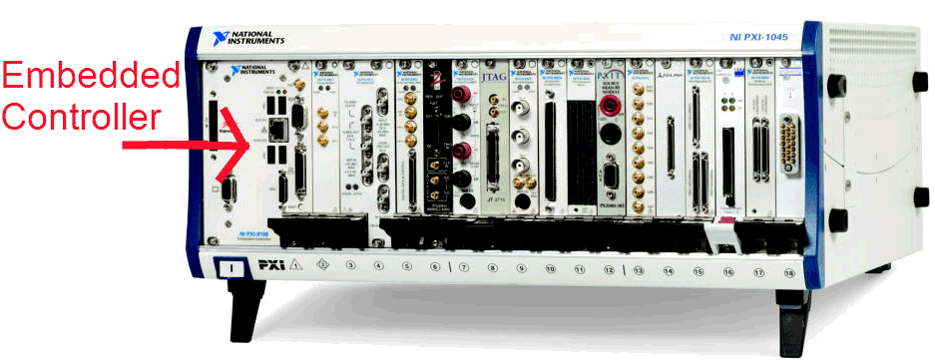
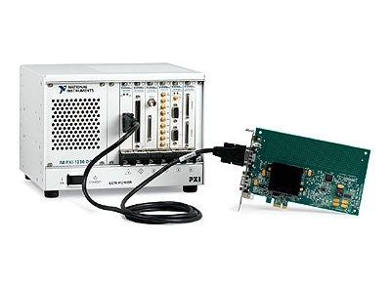
Options for Controlling PXI Switches
Embedded controller
MXI

Slide 64
Options for Controlling SCXI Switches
DMM
E, M, or X Series DAQ device
USB Controller USB-1359
This option is useful when using 3rd party measurement devices
(Obsolete) NI 4021 PCI/PXI controller
The SCXI Getting Started Guide has extensive details on controlling SCXI chassis and the modules in them
For more information on how to install and control SCXI Switches refer to the NI Switches Getting Started Guide-NI SCXI.pdf

Slide 65
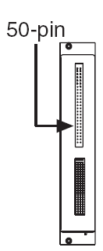
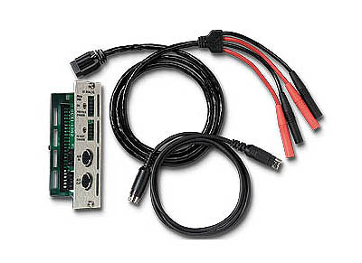
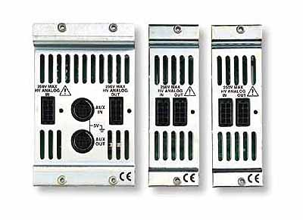
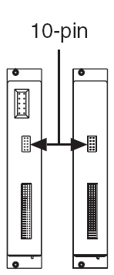
Controlling SCXI Switches with DMM
50 pin rear connector on SCXI module → SCXI-1362 adapter kit
10 pin rear connector on SCXI module → SCXI-1357,1358,1359 backplane adapter kit

Slide 66



Controlling SCXI Switches with DMM
Switch
Connectors
DMM
Chassis

Slide 67


Controlling SCXI Switches with DAQ
50 pin rear connector → SCXI-1349 adapter
10 pin rear connector
Cable DAQ to another SCXI module with 50 pins OR
Place controlling DAQ device in rightmost slot of PXI-1050 combo chassis

Slide 68
Controlling SCXI Switches with Combo Chassis
No external cabling required
Controlling PXI module is in rightmost slot
DAQ or DMM module
Only if NOT hybrid slot compatible
Must be a PXI/SCXI combo chassis

Slide 69

Controlling SCXI Switches with USB
USB-1357,1358,1359 Plug-and-Play Backplane
Can only connect to switches with 10 pin rear connector
Can control switches with 50 pin rear connector when cabled to a 10 pin rear connector in same chassis

Slide 70

Controlling SCXI Switches with the NI 4021
Available in PCI and PXI form factor
Obsolete
New customers should use USB-1359 plug-and-play adapter

Slide 71
Quiz
Why don’t you need a DMM, USB, or DAQ board to control a PXI switch?
Notes:
1. Because the host computer with MXI or the PXI Embedded controller controls the switch for you.

Slide 72
Installing NI Switches

Slide 73


Installing Switches
PXI: Easy
SCXI: Read the manual

Slide 74
SCXI Installation
Notes:
If the system is existing, simply add the new modules in MAX. Make sure the controller is able to talk to the new switches. For example, if you have a 4060 controlling an existing system, then you will not be able to talk to some new switches. See the previous slide.

Slide 75
Procedure 1

Slide 76

Procedure 1
Simply insert your switch and add it in MAX

Slide 77
Procedure 2
Notes:
PXI Express compatible cards have different connectors which plug into the PXI chassis’s backplane. Due to the differences in the connectors, some functionality changed, including the ability to control devices in the chassis.

Slide 78
Procedure 2
Use this procedure to install an NI SCXI switch module in any of the following configurations:
NI SCXI-1000/1001 chassis with an NI PCI or NI PXI switch controller
NI PXI-1010/1050 chassis with a switch controller not in the rightmost PXI slot of the chassis
NI PXI-1010/1050 chassis with an NI PXI Express switch controller in any slot of the chassis

Slide 79

Procedure 2
Cabling an E or M series DAQ device to an SCXI switch module

Slide 80

Procedure 2
Cabling an NI 4021/4060/407x to a 50-Pin Rear Connector Switch Module

Slide 81

Procedure 2
Cabling an NI 4021/4060/407x to a 10-Pin Rear Connector Switch Module

Slide 82
Procedure 3

Slide 83
Procedure 3
Use this procedure to install an NI SCXI switch module in any of the following configurations:
NI PXI-1011/1052 chassis with a switch controller not in the rightmost PXI slot of the chassis
NI PXI-1011/1052 chassis with an NI PXI Express switch controller in any slot of the chassis

Slide 84

Procedure 3
Notes:
Use this procedure to install an NI SCXI switch module in any of the
following configurations:
• NI PXI-1011/1052 chassis with a switch controller not in the rightmost
PXI slot of the chassis
• NI PXI-1011/1052 chassis with an NI PXI Express switch controller in
any slot of the chassis
In these configurations, you can control NI SCXI switches using an
SH9MD-AUX cable. Refer to Table 1 to verify that the controller supports
the NI SCXI switch module you are installing.

Slide 85
Procedure 4

Slide 86
Procedure 4
Use this procedure to install an NI SCXI switch module in an NI PXI-1010/1011/1050/1052 chassis with a PXI switch controller in the rightmost PXI slot of the chassis.
In this configuration, no cables are required to connect the switch module to the controller.

Slide 87

Procedure 4

Slide 88
Procedure 5

Slide 89

Procedure 5
Use this procedure to connect an NI USB switch controller/adapter directly to an NI SCXI switch module with a 10-pin rear connector

Slide 90
QUIZ
Where would you find information about installing and configuring NI switches?
Notes:
NI Switches Getting Start Guide
10-pin or 50-pin connector
SCXI-1357,1358,1359, the USB-1357, 1358, 1359 , SCXI-1362, SCXI-1349

Slide 91
Programming NI Switches

Slide 92
NI-SWITCH Soft Front Panel
Equivalent to a test panel for DAQ devices
Monitor relay positions with adjustable refresh rate
Easily make your first connection
Debugging tools
Clickable switch schematics
Individual relay control for advanced users
Access number of cycles on each relay
Notes:
The SFP is a very important debugging tool and allow to make a connection without having to program the switch with an ADE. It can also be used to actuate relays or to monitor relay states while another process actuates relays.

Slide 93
Exercise
Switch Soft Front Panel
Approximate time to complete: 5 minutes
To demonstrate the use of the Switch Soft Front Panel to control switches.
OBJECTIVE
Notes:
This exercise shows how to use the soft front panel to control switches. Have the students open the soft front panel and get accustomed to the API.

Slide 94



NI-SWITCH Soft Front Panel
Matrix
MUX
General Purpose
AND MORE!
Notes:
When the topology is selected, a graphical schematic is shown. This schematic is clickable to connect rows and columns, channels or change relay states.

Slide 95


NI-SWITCH Soft Front Panel
Notes:
In the relay tab, you can monitor which relays are closed or opened. To allow user to be able to change the relay state from this tab, enable the Enable changing relay positions checkbox in the File»Options menu, as seen above.
Note: Once you change a relay’s state on the relay tab, the schematics tab might not reflect the true state of the switch module.

Slide 96
Programming NI Switches in LabVIEW
Good - NI-SWITCH
IVI-compliant driver
Session based; unique session for each module
Supported in Real-Time
Bad - IVI
IVI-compliant driver
Session based; unique session for each module
BEST - NI Switch Executive
Graphical Configuration
Multiple Modules
Easiest programming
Better - NI-DAQmx
Not IVI-compliant
Single scan list can span multiple devices
Linux support for several modules
Supported in Real-Time
Fastest method
Notes:
See AE KB 43CFNUAY: Choosing Between the NI-SWITCH API and the DAQmx Switch API for Switch Applications for more information.

Slide 97



NI Switch APIs
NI Switch Executive
NI-SWITCH
NI-DAQmx

Slide 98

NI-SWITCH VI Tree

Slide 99

Programming NI Switches in LabVIEW
Immediate
Initialize
Close
Scanning
Immediate Mode: Software sends commands during runtime
Connect/Disconnect Channels
Individual relay control (open and close)
Scanning: Multiple commands downloaded to module memory
Each trigger advances module to next state in scan list
Integrated hardware triggers decrease overall test time
Software-defined triggers supported
Notes:
There are three ways to operate a switch device :
1a. Individual Control of Relays
Open/close individual relays on the switch device
1b. Create Signal Paths
Create/Destroy signal paths between two signal connections (channels) on the switch device. Any internal relays between the source and destination will also be taken care of for you.
2. Scanning
Sequence through a list of channels.

Slide 100

Immediate Mode Connect/ Disconnect Channels
NI-SWITCH
Notes:
Note the similarity of the calls with NI-SWITCH and NI-DAQmx

Slide 101

Immediate Mode Connect/Disconnect Channels
NI-DAQmx
Notes:
Note the similarity of the calls with NI-SWITCH and NI-DAQmx

Slide 102

Immediate Mode NI-Switch Relay Control API
NI-SWITCH
Control specific relays by name
For example: close kr2c3
Ignores safety/exclusions/etc

Slide 103

Immediate Mode DAQmx Relay Control API
NI-DAQmx

Slide 104
Exercise
Immediate Mode Examples
Approximate time to complete: 5 minutes
OBJECTIVE
Open the Immediate mode examples from example finder. Notice the differences between NI-SWITCH and NI-DAQmx

Slide 105
Scanning
Connections synchronized with an external HW trigger or with a software event
Connection operations entered in a scan list that is then downloaded to the memory of switch
Next connection retrieved from Switch memory at next trigger
Scan list is not reconfigurable while running- have to stop task and redeploy new list to memory
The first entry in the scan list is executed when the scan is initiated, trigger settings determine how the switch advances through subsequent entries in the list
Notes:
Scanning
To perform a scan on a switch device users have to supply a list of channels to scan. The channel connections and trigger conditions are programmed using a scan list. The driver converts the scan list to the appropriate hardware commands and downloads them into memory located on the switch device. The scanning process uses triggers to communicate between the measurement (or source) device and the switch device. Once scanning has been initiated, the switch module executes the scan list independent of the host CPU.
Triggering:
In synchronous scanning the measurement (or source) device emits a digital pulse when it finishes a measurement (or generation) on a channel. This action causes the switch device to advance to the next channel. After a programmable delay has occurred, the measurement (or generation ) device takes another measurement (or generates another waveform) without requiring an external trigger.
In handshaking , the measurement (or source) device emits a digital pulse when it finishes a measurement (or generation) on a channel. This action causes the switch device to advance to the next channel. When the switch device has settled, it emits a digital pulse. When the measurement (or generation) device receives this pulse, it takes another measurement (or generates another waveform).

Slide 106
Scan List Syntax: Scan Modes
Mode | Description
Break Before Make (default) | Connections from previous scan list entry are automatically disconnected before executing the current scan list entry. Disconnect actions (~) are not valid in this mode
No Action | Connections remain connected until they are explicitly disconnected by a disconnect action (~)
Break After Make | Currently not supported.

Slide 107

Scan List Syntax
* Listed in NI Switches Help
Character(s) | Definition
-> | Used in a connect action, “ch0->com0”
~ | Used in a disconnect action, Valid only in No Action mode, “~ch0->com0”
; | Wait for debounce after connection, “ch0->com0;”
& | Separates two actions, “ch0->com0 & ch9->com1”
&& | Wait for debounce between connections, “ch0->com0 && ch9->com1”
: | Used when scanning through a range of channels, represents multiple scan list entries, “ch0:7->com0;” **A semicolon must appear after the connect action using a channel range.
Notes:
-> “ch0->com0” connects channel 0 to common 0.
~ “~ch0->com0” disconnects channel 0 and common 0.
& the string “ch0->com0 & ch9->com1” means connect CH0 to COM0 and CH9 to COM1 (in no particular order and with minimal delay)
&& indicates the separation of two actions where there is a wait for relays to settle in between, “ch0->com0 && ch9->com1”
: “ch0:7->com0;” represents eight scan list entries.

Slide 108
Scan List Syntax: NI-SWITCH vs DAQmx
NI-Switch only allows one switch module to be programmed at a time; therefore, a device indicator is unnecessary
ch0->com0; ch1->com0;
DAQmx Switch allows multiple modules to be programmed, and a device indicator must be included
/Dev1/ch0->com0; /Dev2/ch1->com0;

Slide 109
Scanning Trigger Schemes
3 trigger schemes for scanning:
Software Scanning
Synchronous Scanning
Handshaking
Synchronous scanning & handshaking are used with DMMs and will be covered in greater depth in DMM training
Notes:
Triggering:
In synchronous scanning the measurement (or source) device emits a digital pulse when it finishes a measurement (or generation) on a channel. This action causes the switch device to advance to the next channel. After a programmable delay has occurred, the measurement (or generation ) device takes another measurement (or generates another waveform) without requiring an external trigger.
In handshaking , the measurement (or source) device emits a digital pulse when it finishes a measurement (or generation) on a channel. This action causes the switch device to advance to the next channel. When the switch device has settled, it emits a digital pulse. When the measurement (or generation) device receives this pulse, it takes another measurement (or generates another waveform).

Slide 110

Software Scanning with NI-SWITCH
Notes:
The program advances through the user defined scan list with each press of a front panel button. Notice the configure scan trigger VI has Software Trigger Function selected for trigger input. Notice also that the block diagram that the front panel “Next Connection” Boolean controls a case structure which sends the trigger when the button is pressed.

Slide 111

Software Scanning with NI-DAQmx

Slide 112
Example of Hardware Scanning
Hardware Scanning Trigger Schemes
Synchronous Scanning
Handshaking
These modes of scanning use External Hardware Triggers, rather than a software button, to advance through the scan list. The next exercise will use the DAQ Accessory’s Digital trigger to scan through a scan list
Notes:
There are numerous ways to tell the switch when to advance: send a software trigger using the Send SW Trig VI, connect to the Switch Advance terminal on the switch terminal block, connect to the AUX connector (available on some switches and DMMs) using an AUX-AUX cable, use TTL lines on the backplane, etc.

Slide 113
Multi-Module Scanning
Recommend that customers use DAQmx for handshaking
Must make external connections to pass analog signals
PXI has no analog bus, so must be external
SwitchBlock has analog bus, but only within SwitchBlock
SCXI has analog bus

Slide 114
Exercise
Hardware Trigger Scanning
Approximate time to complete: 25 minutes
To demonstrate signal connection and scanning. Use the digital trigger of the DAQ accessory to multiplex switch channels to an analog input channel.
OBJECTIVE
Notes:
This exercise shows how to connect signals through a switch module to the analog input of a DAQ device.
In this exercise we will program the switch to advance the user-defined scan list each time the Digital Trigger button on the DAQ Accessory is pressed. The main take away from this exercise is how to set up a switch with an external hardware trigger using NI-SWITCH.
This exercise requires the following equipment:
PXI Chassis
PXI-6040e DAQ
PXI-2503 Switch
DAQ Signal Accessory
SH68-68 Cable
DMM/Switch Accessory (The DMM/Switch Accessory is a custom terminal block designed for demonstrating the speed and accuracy of National Instruments digital multimeters (DMMs) and NI PXI-2501 or NI PXI-2503 switches. You can route and measure the internal signals on the accessory with National Instruments DMMs and switch modules.)
Three 5” wires (wires shorter than this will prevent the DMM/Switch Accessory from plugging into the 2503)

Slide 115

DMM/Switch Express VI: Switching Tab
Switching tab configures which switch and channels to use in scanning mode with the DMM
Note: simulated switch modules do not work with DMM/Switch Express VI
(tab grayed out)
Notes:
Note: If the switching tab is grayed out, that’s because you don’t have any real switch modules… simulated switch modules won’t work with this express VI because simulated hardware can’t tell where other simulated hardware is in the simulated system.

Slide 116

NI Switches Help
Fundamentals (relay types, topologies, switching considerations, RF, Scanning)
Devices (topologies, programming mode, triggering, expansion, etc.)
Programming (flow, mode, DMM scanning)
Pinouts
First place you should look for non-specification-related questions

Slide 117
NI-SWITCH Documentation
Specifications
Terminal block installation instructions
Getting Started Guide
NI Switches Help
Readme
Instrument driver quick reference guide
\Program Files\IVI\Drivers\niSwitch\Documentation
Notes:
This is the documentation installed by NI-SWITCH and the location.

Slide 118
QUIZ
Which APIs can you use to program NI switches?
Name at least one reason for selecting each of the APIs from the previous question .
What are the different modes you can use to program NI switches?
What is scanning?
Notes:
NI-Switch, NI-DAQmx » Switches, Switch Executive, IVI
A. Switch - IVI compliance
B. DAQmx - Easier multi-module scanning, some Linux support
C. Switch Executive - Save multiple configurations, Configurations given logical names
D. IVI – No Reasons…
3. Immediate vs Scanning
4. Downloading a scan list to the module then executing through hardware timed switching

Slide 119
Connectivity and Expansion

Slide 120





Switch Connectivity

Slide 121

Cable
Cable connects directly to front connector on module
Some modules that use cables also have screw-terminal connector blocks
LFH 200 to 50-pin DSUB cable
Connector Block
Cable
Module
PXI-2575 198-ch multiplexer uses a cabling solution

Slide 122
Connector Blocks
Not front-mounting
Connector blocks are usually used with cables
Connector blocks provide screw terminals to connect to signals on the DUT using bare wires
TBX-50 Connector Block
Connector Block
Cable
Module
Customers can use the TBX-50 screw terminal block when connecting signals to the PXI-2575 198-ch multiplexer
Notes:
A connector block is also referred to as a breakout box.

Slide 123



Terminal Block
Usually front-mounting
Could have screw terminals or ribbon-cable headers
The PXI-2532 uses a front-mounting terminal block with ribbon cable headers
The PXI-2527 uses a front-mounting terminal block with screw terminals

Slide 124




Connector/Backshell
Requires construction on the user’s part
Some backshell/connector kits have solder cups other use crimp and poke method
Look at 2586 manual
Separate and strip each conductor/wire in the cable then insert and clamp into the appropriate position of the connector according to the device pinout
Connectivity to the PXI-2584 is done via a connector/backshell kit

Slide 125



RF Cables
Coaxial/RF cables are designed to minimize losses during signal routing at higher frequencies
All NI RF switch modules use SMA/SMB/MCX/mini SMB coaxial cables
Typically one cable is required for each connection on the RF module (Input and output)
75Ω & 50Ω available depending on application
The NI PXI-2557 75Ω 8x1 multiplexer requires 9 mini SMB coaxial cables

Slide 126
RF Connectivity Is Important!
20 MHz signal
Bottle Neck
Signal that needs to be routed (20 MHz sine wave)
9 MHz bandwidth (-3 dB)
20 MHz bandwidth (-3 dB) in 1-wire configuration

Slide 127
Look in spec sheet for connectivity options
Cables have their own installation instructions
Switch pinouts are in NI Switches help or in the cable installation manual
Won’t find them in MAX, spec sheet, etc.

Slide 128
Connectivity for NI Switches
Model Number | Cable | Terminal Block | Discrete | Mass Interconnect | Cable Backshell
2568, xx69, 2570, xx75, xx76 | X | X (External) |  | X
2501/2503 | X | X |  | X
1127/28, xx29, xx30, 2532 |  | X |  | X
xx90, xx93, xx94, 254x, 255x |  |  | X | X
2564, Xx67, xx84 | X* |  |  | X | X
2565, xx66 | X* | X |  | X | X
1160/61/63r |  | X |  | X
* If not available at NI then can be purchased from third-party vendors (ex: www.l-com.com)
Notes:
As I mentioned earlier, NI switches come with a number of different connectivity options. Low-density switches like the 2501 or 2503 have terminal blocks that can be used for simple switch prototyping. When it’s time to deploy them, you can switch to the cable option. Other switches like the 2567 or 1167 have such common connectors (78-pin dsubs) that we don’t offer a cable ourselves – we ship a cable backshell and connector. There are a number of vendors on the market that can provide cheap dsub cables for these modules. (One vendor is listed on the slide.)
For large ATE systems, all of our modules are compatible with mass interconnect solutions. What is mass interconnect?

Slide 129


Mass Interconnect/Fixturing Compatibility
Customized signal connections, designed specifically for custom applications.
Notes:
Customized signal connections. Designed specifically for custom applications. EXTREMELY CUSTOM!
Both Virginia Panel and MAC Panel are NI Alliance members that produce mass interconnect products.

Slide 130
Matrix and Multiplexer Expansion
Parallel commons, Row/Column Expansion
Notes:
The three most common switch topologies for switching applications are General Purpose (GP), Multipexer (Mux), and Matrix . The following slides will discuss the topologies in more detail and give NI examples of each.

Slide 131

Multiplexer Expansion
Ch 0
Note: Does not work with RF
Ch 1
4-Channel Multiplexer
COM
Ch 2
Ch 3
Ch 0
Ch 1
4-Channel Multiplexer
COM
Ch 2
Ch 3
Notes:
Only short circuit the COMs in a low frequency application. When use high frequency application, could get reflections from destination back to the second multiplexer.
Later in the presentation, we will discuss how you can do matrix and multiplexer expansion with NI switches specifically.

Slide 132
Multiplexer Expansion, RF
Dual 4-Channel Multiplexers
Ch 0
Ch 1
COM
2-Channel Multiplexer
Ch 2
Ch 3
COM
Ch 0
Ch 1
Ch 2
Ch 3
8x1 Multiplexer
Notes:
Only short circuit the COMs in a low frequency application. When use high frequency application, could get reflections from destination back to the second multiplexer.
Later in the presentation, we will discuss how you can do matrix and multiplexer expansion with NI switches specifically.

Slide 133
Building Larger Matrices
Use individual matrix modules as building blocks for larger matrices by :
Connecting rows
Connecting columns
Connecting both rows and columns
Notes:
For applications that require larger matrices than can be provided by a single module, multiple modules may be connected. Matrices with thousands of cross-points are possible for applications that have large numbers of test points. Connecting rows together increases the number of columns available. Connecting columns together increases the number of rows.

Slide 134

Matrix: Column Expansion
Increase column count by connecting rows of individual matrices
C0
C1
C2
C3
C0
C1
C2
C3
R0
R0
R1
R1
R2
R2
3x4
3x4
Notes:
Connecting the rows of these two 3x4 matrices creates a single 3x8 matrix.

Slide 135

Matrix: Row Expansion
Increase row count by connecting columns of individual matrices
C0
C1
C2
C3
R0
3x4
R1
R2
C0
C1
C2
C3
R0
3x4
R1
R2
Notes:
Connecting the columns of the two 3x4 matrices creates a single 6x4 matrix.

Slide 136

Row and Column Expansion
8x128 matrix
1-wire
Number of wires required, using 4x64 matrices:
= 8 (rows) + 128 (columns)
= 136 wires
Notes:
Combining row and column connection using four 4x64 matrices creates a single 8x128 matrix. This requires 136 individual wires, which is very time consuming.

Slide 137
Native Expansion Options?
If help topic mentions expansion, there’s an easy way to expand amongst multiple modules, provided by National Instruments (discussed later)
If no mention, must use bare wires connected externally
NI SwitchBlock provides very easy Column Expansion (discussed later)
Notes:
Mention Switch block expressly designed for this purpose- high density matrices, will go into detail later

Slide 138
QUIZ
What are the different types of topologies?
Why use a multiplexer?
Why use a matrix?
What is difference between 1-wire, 2-wire, and 4-wire switch topologies?
If you connect the rows of 2 matrices what do you expand?
Notes:
1 General Purpose, Matrix, MUX, Independent
2 Allows one or more inputs to be routed to a single output, or vice versa
3 Any number of inputs can be connected to any number of outputs
4 The name indicates the number of wires that are routed in parallel through the switch for each channel
5 Columns

Slide 139
Expansion for modules
Expansion connectivity is module dependent
Some modules expand easily with adapters/cables
Bare wire connection is always possible
Check NI Switches Help for details

Slide 140


SCXI Expansion

Slide 141

High Voltage Analog Bus (HVAB)
Routing signals from one module to the other
Routing signals to DMM via HVAB (AB0, AB2)
Multiplex and Matrix (row only) expansion
CONNECTS HVAB OF ADJACENT MODULES
Notes:
The HVAB (High Voltage Analog Bus) is essential for routing signals between modules, to a DMM, and expanding rows on multiplexer and matrix configurations.
For example, using the SCXI-1357 above, we could use the HV Analog IN connector to transfer signals from the switch module to one of our DMMs via the HV8-BAN4 cable. The HV Analog OUT on the SCXI-1357 could then be routed to another SCXI-1127 module’s HV Analog IN connector using an analog bus plug. See slide 63 for a picture of some of these cables used with this adapter.

Slide 142
MUX Expansion Example SCXI 1127/28
For 2 modules
For 3 modules
1 HVAB
expansion
plug
For 12 modules
3 HVAB
expansion
plugs
Notes:
The SCXI-1357 kit includes one 2-slot HVAB adapter, two 1-slot adapters, and the necessary cables.
The SCXI-1358 kit includes one 8-slot HVAB adapter, one 2-slot adapter, two 1-slot adapters, and necessary cables.
The SCXI-1359 kit includes the NI SCXI-1357 high-voltage 2-slot backplane adapter and cable that connects the digital control lines of NI 407x DMMs, NI 4060 DMMs, or NI 4021 switch controllers to the switch modules.

Slide 143

SCXI Example: Column Expansion, SCXI-1129
Expansion cables connect rows and expand columns (SCXI-1334, 1335 terminal blocks)
Notes:
For a more detailed discussion, check out the Matrix Switch Expansion Guide (AN 174) on Dev Zone.
Figure 3 of Matrix Switch Expansion Guide gives more details about the connections to make.

Slide 144

Row Expansion Example SCXI-1129
The expansion plugs connects the columns of adjacent
SCXI-1129 terminal blocks and expands the rows
(all terminal block except 1337, 1339)
Notes:
Expansion plugs make column expansion quick and easy. Connecting two adjacent matrix modules creates a matrix with twice the number columns. Connection points are at both the top and bottom of the terminal blocks, making it possible to connect an entire chassis of modules into a single matrix.
Expansion cables allow you to increase your column count

Slide 145

PXI Expansion

Slide 146


MUX Expansion Example PXI-2501/2503
Expansion in Multiplexer mode possible using analog bus expansion connectors in front of TB-2605.
TB-2605
Notes:
The TB-2605 terminal block is sold with one analog bus connector piece. This connector plugs into the front of two adjacent TB-2605s, in one of the plugs seen circles in the picture, to route signals from one PXI 2501/2503 module to another. Connecting two NI PXI-2501/2503 modules using their analog bus in 2-wire 24×1 multiplexer topology creates a 2-wire 48×1 multiplexer.
You can also route the signals to another device such as a DMM. Using the LV6-BAN4 cable you can also route the common to an NI 4070 DMM for measurement

Slide 147

Matrix Expansion Example Using Terminal Blocks - PXI-2529
Expand the PXI-2529 columns using the TB-2634
Connect adjacent terminal blocks with ribbon cables

Slide 148

Matrix Expansion Example Using the Module itself - PXI-2535/2536
Column expansion using SHC68-C68-S cable
No row expansion

Slide 149
Matrix Expansion Formula
Example: Need 21x50 Matrix from 4x8 modules
1) Divide number of rows desired by number of rows in single module and round up: 21/4=5.25 → 6 modules
2) Same operation with the columns:
50/8=6.25 → 7 modules
3) multiply the value found in 1) by the value found in 2):
6x7= 42 modules, which will create a 24x56 matrix.
Notes:
For more information:
Matrix Switch Expansion Guide
http://zone.ni.com/devzone/cda/tut/p/id/3628

Slide 150
Matrix Expansion Exercise
Determine the number of SCXI-1129 modules required to create a 16x128 matrix with the SCXI-1336 connector block.
Determine the number of PXI-2532 modules required to create a 2-wire 16x128 matrix with the TB-2643 connector block.
Notes:
Solution:
1. If you use a SCXI-1336, you can configure the SCXI-1129 in a 16X16 matrix.
Rows: 16/16 = 1
Columns: 128/16 = 8
1 times 8 = 8 modules
2. If you use a TB-2643, you can configure the PXI-2532 in a 2-wire 4X64 matrix
Rows: 16/4 = 4
Columns: 128/64 = 2
4 times 2 = 8 modules

Slide 151
PXI Switch Selection Exercise
How many/what type of switch modules are needed for:
DMM, Power Supply and a DSA each to 30 DUTs
Differential signal
20 VDC, 200 mA
PXI form factor
200 cycles/s
Lowest cost
Notes:
Searching for PXI, Matrix, and 100mA, there are several products. You need to choose a 2-wire configuration, but BE CAREFUL! Some of them list the multiplexer (1-wire) in the results page, but have 2-wire matrix configurations when you compare them. Also, because the customer asks for 200 mA, some AEs will choose “At least 1A”, but that will eliminate the switches that handle a max of 400 or 500 mA, which should be considered.
Removing modules in the compare screen to 2-wire and scanning speed, there are four: (2530, 2532, 2503, 2501)
2530 4x16 $1,799 2 modules = $3,598 + 2x$249 (TBs) = $4,096
2532 4x64 $5,099 1 modules = $5,099 + $299 (TB) = $5,398
2503 4x6 $1,099 5 modules = $5,495
Note: Prices are from 1/30/2008

Slide 152
PXI Switch Selection Exercise: Part 2
How many/what type of switch modules are needed to expand to 300 DUTs?
DMM, Power Supply and a DSA each to 300 DUTs
Differential signal
20 VDC, 200 mA
PXI form factor
200 cycles/s
Lowest cost
Notes:
2530 4x16 $1,799 19 modules = $34,181
2531 4x64 $5,099 5 modules = $25,495 – not to mention all the chassis and terminal blocks needed for other setups. Better yet, let’s look at SwitchBlock (all expansion is internal)
2503 4x6 $1,099 50 modules = $54950
Note: Prices are from 1/30/2008

Slide 153
NI SwitchBlock
Notes:
Used for large matrix applications. This is an advanced switch topic and will be discussed later in this training.

Slide 154
Why NI SwitchBlock?
Very Large Matrix Applications
Modular and expandable
Easily configure up to a 4x2064 or 8x1104 Matrix in a single 18 slot PXI chassis.
Previous large matrix option was multiple PXI-2532’s which required excessive external wiring

Slide 155







Components of the NI SwitchBlock
Carrier
Relay Card
Expansion Bridge
Carrier
Relay Card
Expansion Bridge
Reed relay cards
0.3 A: 4x86, 8x46, 16x22 cards available
1 A: 4x43, 8x21, 16x9, 4x21 (2-wire), 8x9 (2-wire) cards available
2 A: 4x71 (2-wire), 8x34 (2-wire)
More cards in development!
*2 A modules require 2 slots
4 PXI Slots
Fits in between carriers
Extends analog bus lines
Connect multiple carriers together
6 Relay Card Slots
Analog Bus
Notes:
The SwitchBlock is made up of three components.
The first is the four-slot PXI Carrier which fits into any hybrid-compatible PXI-slot, includes an integrated analog bus and holds up to 6 relay cards.
Our initial set of relay cards are reed matrices that come in both 0.5 and 1 A versions. Additional relay cards are already in development for future expansion of the NI SwitchBlock offering.
The NI SwitchBlock Expansion Bridge can be used to build large switch matrices by connecting adjacent carriers and extending their analog bus lines.

Slide 156

NI SwitchBlock Architecture
Matrix relay cards connect through the analog bus on the Carrier
This architecture favors column-to-column signal routing
NI SwitchBlock Carrier
Analog Bus Lines
Analog Bus Relays
NOTE: Must Connect Safety Interlock Protection Resistor to access Analog Bus!
Notes:
The NI SwitchBlock architecture performs matrix expansion by connecting the rows of each individual matrix module to the analog bus on the carrier, allowing signals to get from one module to the next. Relay cards can be used as part of a larger matrix, or as individual matrix modules by connecting or disconnecting the analog bus relays.

Slide 157

NI SwitchBlock Architecture Cont.
Notes:
Another look at the relationship between the cards and carrier connections.
Relays at the junction between rows and columns on each board. And relays on each board that connect and disconnect the rows to the Carrier’s Analog Bus.

Slide 158
NI SwitchBlock Relay Cards: A vs. B
NI SwitchBlock Carrier
Analog Bus Lines
Type-B Module
Type-A Module
A
B
Columns
Columns
Analog
Bus Lines
Notes:
To optimize bandwidth and reduce capacitance, NI SwitchBlock relay cards come in a Type A and Type B design.
The front connector on the Type B relay cards provides direct access only to the columns of the relay card.
By contrast, the front connector on the Type A relay cards provides direct access to the analog bus of the carrier, as well as the columns of the relay card.
Adding the connections to the analog bus increases capacitance and reduces system bandwidth. Therefore NI recommends the need for a single Type A card per SwitchBlock system. See next slide.

Slide 159
NI SwitchBlock Relay Cards
Recommended relay card configurations:
ONLY 1 A CARD PER SYSTEM!
Column-to-Column
Row-to-Column
A+B
B
Notes:
Now, here's how all of this fits together:
For Row-to-Column Signal Routing: Use one A card placed in the center of the NI SwitchBlock and fill the rest of the slots with Type B cards. For multicarrier switch systems, the Type A card should be placed in the middle of the adjacent carriers. The Type A card will provide access to the rows through the analog bus lines on the front connector.
For Column-to-Column Signal Routing: Use only Type B cards

Slide 160




NI SwitchBlock Carrier
Safety Features
Rated for Measurement CAT I
Route signals up to 150 V along the analog bus
6 Relay Card Slots
4 PXI Slots
Analog Bus
Note on Chassis Selection:
The hybrid connector on the carrier is in slot 2
PXIe-1075 can hold two NI SwitchBlock carriers
that cannot be connected using an expansion bridge.
All other NI 18 slot PXI / PXIe chassis can support up to four SwitchBlock Carriers that can be expanded together.
PXIe-1075
Notes:
The Carrier for the NI SwitchBlock has been designed with a specific focus on safety.
It is rated for Measurement CAT I, and can carry signals up to 150 V on the integrated analog bus lines.
I'd also like to point out that the hybid connector is on the back of the second slot of the NI SwitchBlock carrier. With this placement, you should be able to put 4 carriers side by side in all of our 18-slot PXI chassis with the exception of the PXIe-1075.

Slide 161




Combining Cards
Relay cards can be configured individually or or combined into one or multiple devices.
Easy to configure in MAX
Initial Configuration
Combined Configuration

Slide 162
NI SwitchBlock Specifications
NI 2800 (NI SwitchBlock Carrier)
6 Relay Card Slots in 4 PXI module slots
16 Analog bus lines on backplane of carrier
150 Volts CAT I rated Analog Bus
2 Amps max per Analog Bus line

Slide 163

NI Switch Health Center
Relay Self-Test for currently for NI SwitchBlock [For Now].
Test signal sent through each relay
Safety Interlock: Must disconnect all external connections before Switch Health Center will run.
This is to prevent damage to attached devices from the test signal.
Enabled by a 500 Ohm impedance across two connector pins on each relay card.
Notes:
Relay status can be unknown if the test signal’s path contains a known bad relay. In this case the test signal cannot get to the relay trying to be tested, so that relays status cannot be determined.
There was tremendous customer demand for this (NI Switch Health Center) and relay self test.

Slide 164

NI Switch Health Center (cont)
Easily launched from MAX or Start Menu
Notifies user if relays are operating correctly or need to be replaced
Provides Relay Count information
Integrated HTML reporting

Slide 165
NI SwitchBlock Relay Card Specifications
Relay Card | Current Rating | Voltage Rating | Card Topology | Carrier Full | 18 Slot Full
NI 2810 | 1A Switch & Carry | 150V, CAT I | 4x43 1-w | 4x258 | 4x1032
NI 2811 | 1A Switch & Carry | 150V, CAT I | 8x21 1-w | 8x126 | 8x504
NI 2812 | 1A Switch & Carry | 150V, CAT I | 16x9 1-w | 16x54 | 16x216
NI 2813 | 1A Switch & Carry | 150V, CAT I | 4x21 2-w | 4x126 | 4x504
NI 2814 | 1A Switch & Carry | 150V, CAT I | 8x9 2-w | 8x54 | 8x216
NI 2815 | 0.25A Switching 0.3A Carry | 100V, CAT I | 4x86 1-w | 4x516 | 4x2064
NI 2816 | 0.25A Switching 0.3A Carry | 100V, CAT I | 8x46 1-w | 8x276 | 8x1104
NI 2817 | 0.25A Switching 0.3A Carry | 100V, CAT I | 16x21 1-w | 16x126 | 16x504
NI 2833 | 2A Switch & Carry | 100V, CAT I | 4x71 2-w | 4x213 | 4x854
NI 2834 | 2A Switch & Carry | 100V CAT I | 8x32 2-w | 8x96 | 8x384

Slide 166
Matrix Expansion Exercise
Determine the number of SwitchBlock cards required to create a 8x400 matrix
Determine the number of SwitchBlock cards required to create a 8x800 matrix
Determine the number of SwitchBlock cards required to create a 16x200 matrix
Notes:
Solution:
2 carriers filled with 9 NI 2816s (8x46 matrix cards will create a 8*414)
3 carriers filled with 18 NI 2816s (8x46 matrix cards will create a 8*828)
2 carriers filled with 10 NI 2817s (8x22 matrix cards will create a 8*220)

Slide 167
Advanced Switch Topics

Slide 168
Application Examples

Slide 169

Switching Low-Voltage Signals (< 1 mV)
Thermal EMF
Dissimilar metals create a voltage drop at their junction
Typical
Electromechanical: 1 - 10 uV
Reed: 10-80 uV
Creates a thermocouple that varies voltage offset with temperature
Junction | µV/°C
Copper-Copper | <0.3
Copper-Gold | 0.5
Copper-Silver | 0.5
Copper-Brass | 3
Copper-Nickel | 0.5
Copper-Lead-Tin Solder | 1-3
Copper-Aluminum | 5
Copper-Kovar | 40
Copper-Copper Oxide | >500
Notes:
The primary consideration for low voltage measurements is the Thermal EMF or Offset Voltage associated with the relay. Thermal EMF When two, dissimilar metals are joined a voltage is created. This voltage is known as the thermal electromotive force (EMF) or the Seebeck voltage. The Seebeck voltage is dependent on the temperature of the junction and the composition of the metals joined. The specific metal-to-metal junctions result in specific temperature coefficients (µV/°C), also known as Seebeck coefficients. The following table lists the most common metals and their respective Seebeck coefficients.
Thermal EMF in switches
The leads of electromechanical relays are usually composed of metal alloys, most often nickel-iron alloy, while the PCB of a switch module is usually composed of copper or copper alloy. The junction between these two, dissimilar metals creates a thermocouple, as illustrated in the figure below.
Note the offset voltage developed in a relay is dependent on the temperature of the junction. The temperature of a junction varies according to the ambient temperature, the number of relays activated, the air flow inside the switch module, and the types of switch modules located in the adjacent slots.
A signal path can transverse a single relay or multiple relays. The sum of all the thermocouples in a signal path is expressed as the thermal EMF. Thermal EMF can be specified as single path (single wire) or differential path thermal EMF.

Slide 170
Switching Low-Voltage Signals (< 1 mV) (cont)
Minimize the effects of Thermal EMF by using 2-wire topologies
1-wire mode
2-wire mode
+
2.5 μV
+
+
2.6 μV
+
DUT
DMM
DUT
DMM
-
-
-
2.4 μV
-
If DUT = 5 μV
Switch thermal emf = 2.5 μV
DMM measures between 2.5 and 7.5 µV
Measurement error = 50%
DUT = 5 µV,
Switch thermal emf = ± (2.6 -2.4 µV)
DMM measures between 4.8 and 5.2 µV
Measurement error = 4%
Notes:
Using a 2-wire topology minimizes the effects of thermal emf.
1. Similar voltages are introduced on each path through the switch module, and therefore cancel out.
2. Modules are specifically designed such that signals passing through more than one junction or relay will see relays of alternating direction. Alternating the direction allows the voltage introduced by one relay to be negated by the next.

Slide 171
Switching Low Currents (< 10 μA)
Leakage Currents
Can leak to:
Leakage to ground
Channel-to-channel leakage
i
Relay
Channel-to-ground leakage
L
V
s
R_{Leakage}
To DMM
i_{L}
Ch0
C_{G}
i_{leakage}
R_{surface}
Channel-to-Channel leakage
Ch1
C_{c}
Notes:
Not an ideal system, so we do see some current leakage. Currents can leak to ground, as well as to other channels on the relay board.

Slide 172
Switching Low Currents (< 10 μA) (cont)
Minimizing leakage currents
Calibrate your system: Apply step voltage to each individual channel
Choose the a switch with high isolation & low leakage
FET/SSR switches have leakage current injected from the relay itself
Isolate sensitive signals from switch system (use PXI-4022 guard card)
i_{test} - i_{leakage}
HI Sense
DUT
HI
DMM
i_{test}
i_{leakage}
Test Fixture
Guard
+
-
LO Sense
LO
Guarding

Slide 173



Switching Low Currents (< 10 μA) (cont)
Triboelectric Currents
Generated by charge that builds due to friction between conductor and insulator on cable
Occurs when cables are bent or moved excessively
Can be minimized by tying cables down
Electrostatic Interference
High-impedance circuitry is susceptible to pick up noise
Effective shielding of the DUT and cables can help reduce this noise
Settling Time
When relay is closed it bounces before making a connection. This causes a charge transfer which gives rise to a current pulse
What happens when ball is dropped on ground?
Error can be minimized by taking a measurement after settling time of switch has elapsed

Slide 174
Measuring Low Capacitance with Switches
When performing Low Capacitance measurements, the switch cannot add additional error.
Selecting the right topology for these measurements reduces added capacitance
SPDT
Matrix
Select switches with:
Low path resistance
Low minimum current.
Perform averaging on DMM.
Perform Open / Short Compensation on DMM

Slide 175


Other Examples
Switching Inductive Loads
Use MOV and FlyBack diode to reduce voltage spikes
Switching Capacitive Loads
Use resistor in series to prevent inrush current
DMM is a capacitive load!
Low current / voltage Hot Switching
Pay attention to “minimum switching load” spec.
All Armature Relays have this problem

Slide 176
272x Resistor Modules

Slide 177

272x Design Overview
Green relays: Each bank contains 8 ‘bit’ relays (16 bit banks are 2x8)
Red relay: Infinite resistance (open)
Orange relay: ~0 Ohms (short)
Pink relay: Bridge relay between two banks
Not shown: Test relay to connect to front test connector.

Slide 178
272x Design Overview (cont)
By switching the “green” relays, you decrease the resistance of the path.
Resistor values don’t match exact binary values
Manufacturing differences
Temperature offset
Trace and Relay offsets
NOT able to be calibrated
Used to replicate RTDs / other sensors, used for load testing, etc

Slide 179
272x Device Support
Appears like any other switch
Has appropriately named channels
Connection and Relay Control APIs both work
“connect b6->b6r0” vs. “close kb6r0”
Can use DAQmx, IVI, NI-SWITCH, NI Switch Executive as a switch device in independent topology.
NI Recommends the “272x Reference Vis”

Slide 180
NI 272x Reference VIs
Session Based
Resistance Based
“Set Channel 2 to be 100 Ohms”
Installed by Installer
Ensures DAQmx Core Product version > 9.5 installed
Ships with readme and a PDF
Does NOT need NI-SWITCH installed
example finder support (Help >> Find Examples...)
VI palettes to Instrument Control
error code strings
custom “session handle” to follow session paradigm from other MI drivers

Slide 181

272x Example Block Diagram

Slide 182
RF Switch Concepts

Slide 183


NI RF Switch Products
26.5 GHz – 40 GHz
Bandwidth
0 – 500 MHz
500 MHz – 2.7 GHz
2.7 GHz – 6.6 GHz
500 MHz 50Ω switches
4 topologies available
2.5 GHz 75Ω switches
2.7 GHz 50Ω switches
6 topologies available
5 GHz 50Ω 4x1 mux
6.6 GHz 50Ω SSR
26.5 GHz 50Ω switches
40 GHz 50Ω switches
4 topologies available
21 total modules available

Slide 184
RF Switching Specifications
Maximum Bandwidth
Insertion Loss
VSWR
Characteristic Impedance
Crosstalk/Isolation
Termination
Signal Characteristics (Sine or Square, Rise Time, etc.)
Channel Density
Maximum Power

Slide 185
Bandwidth is an arbitrary spec and is not always the -3dB point of switch. When recommending an RF switch to your customer ensure that insertion loss and VSWR of the switch module meet application requirements!
Notes:
Note to Instructor: If you are instructing this course and aren’t comfortable with these RF concepts, please contact the Switches PSE or PME to get a brief tutorial on this information.

Slide 186
What is Insertion Loss?
P_{in}
P_{out}
Source
Load
50Ω
Z_{o}=50Ω
50Ω
Insertion Loss (dB) = 10 * log₁₀ ( P_{out} / P_{in} )
Notes:
Insertion Loss is defined as the ratio of power entering a device (like a switch) to the power leaving it.
IL is always negative when expressed in terms of dB. (power cannot be generated by a passive transmission line).
Because any cable will always have some resistance and conductance, insertion loss is always greater than zero.
Series resistance of the cable increases with frequency (due to the skin effect). Shunt conductance also increases with frequency. Thus, insertion loss will become larger as frequency increases.
The above example assumes a perfectly impedance matched system. In an unmatched system, power that is reflected back to the source due to impedance mismatch will cause a higher insertion loss (see return loss slide for more information)

Slide 187
Why Does Insertion Loss Occur?
R
Ideal Switch
But in reality, switch looks more like this
C = Net Capacitance of Circuit
R = Path Resistance of Switch
Insertion loss measures attenuation and power loss induced by switch
For ideal DC systems, ω=0, therefore V_{out} = V_{in}
Loss is higher at higher frequencies
V_{in}
C
V_{out}
Module ground

Slide 188
Insertion Loss Plot
Industry standard: Bandwidth is -3dB point, disregarding other factors.
NI lists bandwidth as useful limit of module, including other factors.
Bandwidth Spec is not at -3 dB
-3 dB point is close to 3.6 GHz!
Notes:
PXI-2547 bandwidth – 2.7 GHz
Industry standard: Bandwidth is -3dB point, disregarding other factors.
NI lists bandwidth as useful limit of module, including other factors.
PXI-2547 bandwidth is 2.7 GHz, which is not the -3 dB point.

Slide 189
Voltage Standing-Wave Ratio (VSWR)
When waves propagate between mediums, reflections occur (wave theory)
VSWR is a measure of this reflection
Sound wave example
Greater the variation in mediums, greater the reflection
Air
Wall
Reflected
(ECHO)
Propagated

Slide 190
Facts About VSWR
In electrical systems, reflections occur when signal propagates through components with varying characteristic impedances (connectors, relays, traces, etc.)
VSWR measures the power of this reflected signal
VSWR is an important consideration in systems where signal reflections can damage the source
“What exactly is characteristic impedance?” You may ask

Slide 191
Characteristic Impedance
To minimize reflections, RF components are designed to have a certain per unit length impedance or ‘characteristic impedance’
Characteristic impedance is not a DC resistance !!!
Almost all RF systems have characteristic impedance of either 50 or 75 Ω
To minimize reflections and maximize amount of power transferred from source to load transmitted, impedance of all components in RF system must be matched
Source
P_{in}
P_{out}
Load
50Ω
Z_{o}≠ 50Ω
P_{in} = P_{out} and
P_{reflected} = 0
P_{reflected}
50Ω
Matched 50Ω System (Ideal)
Notes:
Characteristic Impedance is not an impedance can be measured with a DMM or other DC measurement device.
The illustration above represents an ideal transmission line model.
Characteristic Impedance is a property based on the Per Unit Length (PUL) ratio of Capacitance and Inductance (and series resistance and shunt conductance, when lossy transmission lines are considered).
Any transmission line has a characteristic impedance.
Because it is based on PUL values, characteristic impedance does not change with cable length (like a DC impedance would).
For common geometries (coax, twinax, microstrip, coplanar waveguide, etc..) characteristic impedance can be calculated using formulas that have already been derived. Just plug in dimensions and physical properties.
At DC, Impedance = resistance.

Slide 192
Calculating VSWR
VSWR = Voltage Standing Wave Ratio
VSWR is the ratio of the maximum to minimum voltage in the standing wave pattern on the transmission line
Impedance Discontinuity
Z_{O}
Z_{L}
Mismatched RF system
Notes:
Reflection coefficient is a ratio of the incident and reflected voltage waves at the point where the load (ZL) connects to the transmission line (Zo)
For RC = 0, the system is matched, and for RC=1, the load is an open or short circuit.
This equation applies only to a single impedance discontinuity between a transmission line and load. In an actual system, impedance may vary over the length of the, making the VSWR equation more complex.
A standing wave is formed by the superposition of two waves propagating in opposite directions.
VSWR and Return Loss measure the same thing: how well the transmission line is impedance matched to source and load.
VSWR is frequency dependant.
VSWR is unitless
An example will be used to demonstrate VSWR

Slide 193
Example : VSWR
In Phase:
180° Out of Phase:
1V_{p-p} Incident Wave (20mW)
100mV_{p-p} Reflected Wave (0.2mW)
Source
Z_{o}=40.5Ω
40.5Ω
50Ω
Maximum - In phase : 1.1V_{p-p}
Minimum - 180° Out of Phase: 0.9V_{p-p}
Notes:
Assume we use a signal generator to put a 1Vp-p sine wave into a transmission line whose other end is terminated.
Also assume that a 0.1Vp-p wave is reflected at the interface between the function generator and the cable.
Because the waves travel in opposite directions, a standing wave is created. A some time, the two waves will be in phase with each other, and at another time, the waves will be 180° out of phase. If we know the magnitude of the voltage at these two times, we can then calculate the VSWR for the cable.

Slide 194
Example : VSWR
In phase: 1.1V_{p-p}
180° Out of Phase: 0.9V_{p-p}
METHOD 1
METHOD 2
Ratio of maximum to minimum voltage in the standing wave pattern on the transmission line
VSWR formula calculation
Notes:
This slide is hidden but included as an extra reference.
VSWR = Magnitude of largest standing wave / magnitude of smallest standing wave.
Note that with more than a single reflected wave, largest or smallest standing waves may not occur when the reflections are in phase/180° out of phase with the incident wave.
Each time an impedance transition is crossed, part of the wave’s power is reflected back. This means an infinite number of reflections for any system with > 1 impedance transitions. This is because of the multiple internal reflections within the transmission line.
One way to measure VSWR is using a Vector Network Analyzer (VNA)

Slide 195
Crosstalk / Isolation
Crosstalk: When an unwanted signal is coupled from one circuit to another.
Example: Between 2 banks on switch module
Isolation: When an unwanted signal is coupled across an open circuit.
Example: open relay
COM1
COM2
Signal carried over between two independent circuits
COM1
Signal carried over open relay
Notes:
When a wave propagating in one circuit (‘source’) induces an unwanted signal on another channel (‘victim’), this is called crosstalk. Crosstalk is usually specified for switches in terms of dB. Crosstalk can be improved by moving the source and victim further apart, or by adding some shielding.
Terminated switches usually exhibit better crosstalk performance because there are at least two open relay contacts between the source and victim channels.

Slide 196
Termination
50Ω Transmission Line
DUT1
Load
Z_{o}=50Ω
50Ω
DUT 1 (50Ω)
50Ω
RFSA
DUT8
50Ω
Z_{o}=50Ω
DUT 8 (50Ω)
Medium change causes the majority of the signal to reflect
R_{Air}
In the case of DUT1, the entire signal route has a characteristic impedance of 50Ω
In the case of DUT8, the open relay causes a break in the 50Ω characteristic impedance of the circuit which results in reflections

Slide 197
Termination (cont)
50Ω Transmission Line
DUT1
Load
Z_{o}=50Ω
50Ω
DUT 1 (50Ω)
50Ω
RFSA
DUT4
Z_{o}=50Ω
50Ω
Termination resistor keeps reflections low
50Ω
DUT 4 (50Ω)
Termination is VERY crucial when the DUT is:
Continuously generating signal
Sensitive to signal reflections

Slide 198

Rise Time
Time required for output signal voltage to rise from 10% to 90%
Important specification when routing square waves
Can be used to approximate 3 dB point of switch (bandwidth)
To route a square wave accurately, rise time of switch must be 1/7th the rise time of the signal itself
Note: When a customer is switching a 1 GHz square wave, ALWAYS recommend a switch with 7x the bandwidth (ie 7GHz switch)

Slide 199


Rise Time (cont)
Slower rise time
Faster rise time
5 MHz Square Wave with 20 MHz Digitizer
5 MHz Square Wave with 300 MHz Digitizer
Notes:
To see why you would need high bandwidth for these time domain measurements, let’s take a look at a real signal. One of the most common measurements when characterizing the shape of a pulse or square wave is rise time.
To measure the rise time of a signal accurately, the digitizer’s rise time much be much smaller/faster and here you can see the relationship between rise time and bandwidth. As bandwidth goes up, rise time goes down (i.e. faster rise time). To understand this further, let’s take a look at this image, which was captured using a 20 MHz digitizer. As you can see the rising edge of the pulse has a curve to it. This is because a square wave is built by a sine wave as fundamental frequency plus many of its harmonics, and by limiting the bandwidth of the digitizer, the higher harmonics have been filtered out.
Now, let’s take a look at the same pulse captured by a 300 MHz digitizer.
<build animation>
Here you can see that the rising edge is much sharper and has a faster rise time.
Large bandwidth is essential for measurements of fast occurring phenomena such as small rise times and glitches.
Next, we’ll see a demo of this measurement using a new 2 GS/s PXI scope.

Slide 200
Quiz
What is the most important specifications when recommending an RF Switch?
Why is proper termination important in RF Switches?
Notes:
Insertion loss and Voltage Standing Wave Ratio (VSWR)
Proper termination prevents reflections from damaging hardware

Slide 201
Good KBs
Save these to a Support >>Switches folder on your machine!
2532 Alignment Procedure – Switch Module with connectivity issues, if you see a customer with an open relay – http://digital.ni.com/public.nsf/allkb/75C05461120A54AC862579640079764A?OpenDocument
RF Concerns – Complete guide to non-specification considerations for RF Switching http://digital.ni.com/public.nsf/websearch/DEDE63FD1E29C740862579D1006A5E42?OpenDocument
RF Specifications – Everything there is to know about RF Switches http://www.ni.com/white-paper/5769/en
Capacitive Load Inrush Current Protection / Inductive Load High Voltage Protection – For the customer who keeps shorting relays http://zone.ni.com/reference/en-XX/help/375472A-01/switch/reed_rly_prot_inrush_prot/ http://zone.ni.com/reference/en-XX/help/375472C-01/switch/switching_inductive/
Basic Relay Selection questions – for the customer who has basic questions on relays http://www.ni.com/white-paper/2774/en
SwitchBlock – Everything you need to know about using the SwitchBlock http://www.ni.com/white-paper/11969/en
Really! Download this powerpoint. And SAVE THESE DOCUMENTS

